Slide 1


Project proposal
Presenter | Sumberzul DULGUUN
Student ID | 20222045
Affiliation | GIST-BMSE-Molecular Biomedical Lab
Course | Data Science in Healthcare (EC6212/AI6212)
Instructor | Hojung Nam, Ph.D

Slide 2
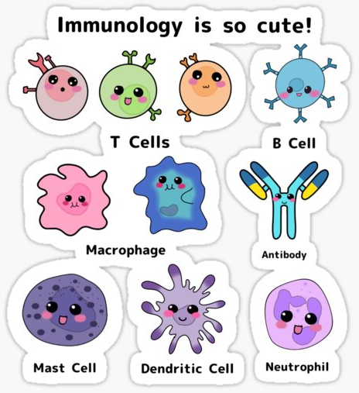
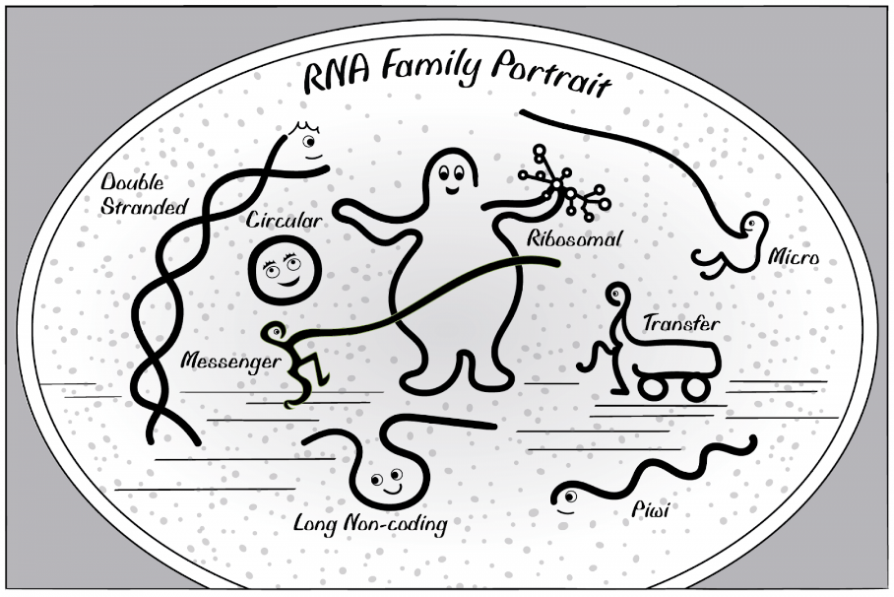
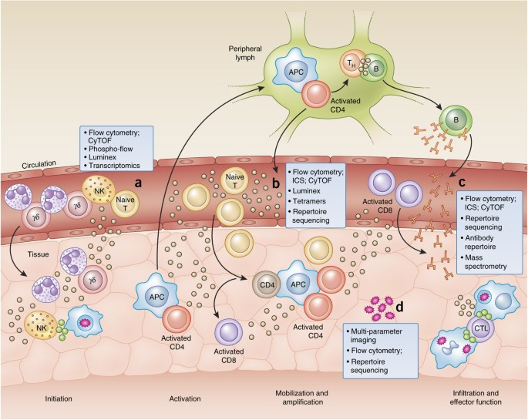
Introduction
Country | Mongolia
Age | 30
Family status | Married for 6 years and have a son
Current student status | PhD candidate
Occupation | General Physician / Surgeon
Experience | High throughput sequence data analysis RNA biology / Ribosome biology Molecular biology Immunology related studies
Research interest | Gene regulation and changes of the post-transcriptional landscape within the innate immunity

Slide 3
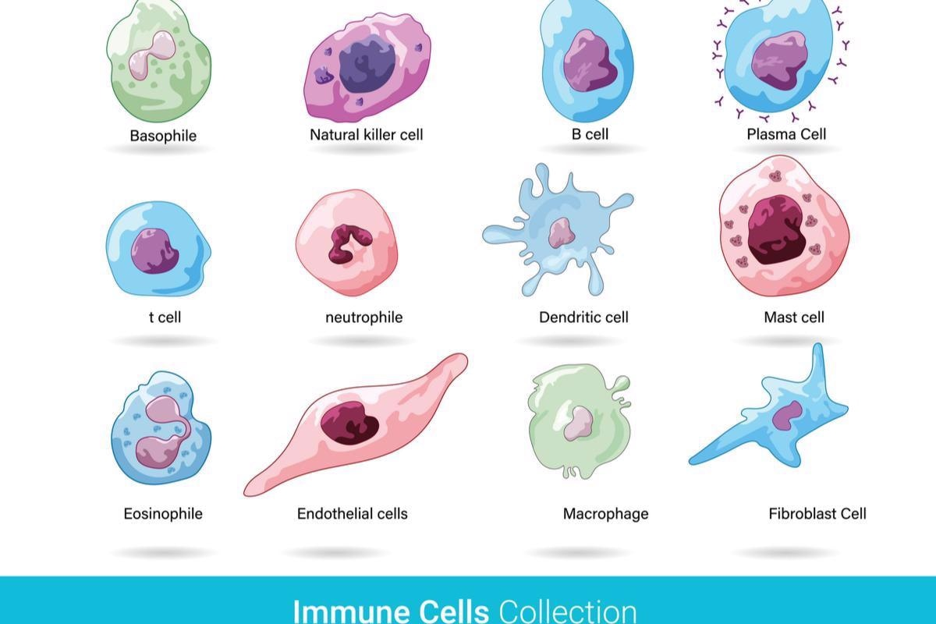

The immunity and its importance, but why?
The immune system is a network of biological systems that protects an organism from diseases. It detects and responds to a wide variety of pathogens, from viruses to parasitic worms, as well as cancer cells and objects such as wood splinters, distinguishing them from the organism's own healthy tissue.

Slide 4

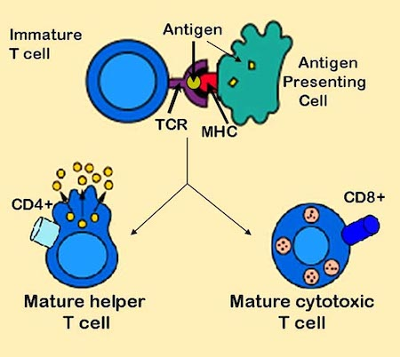
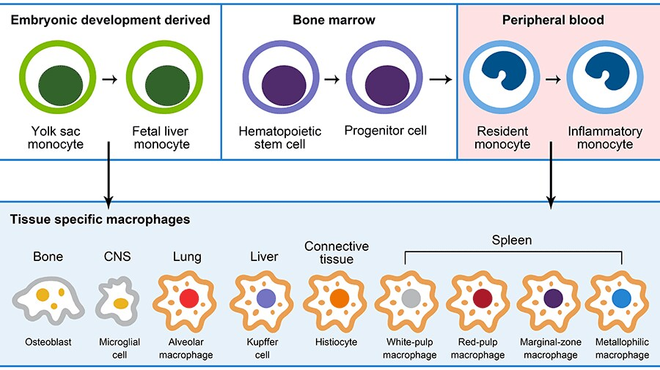
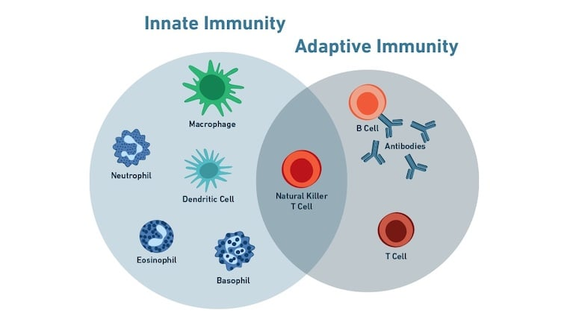
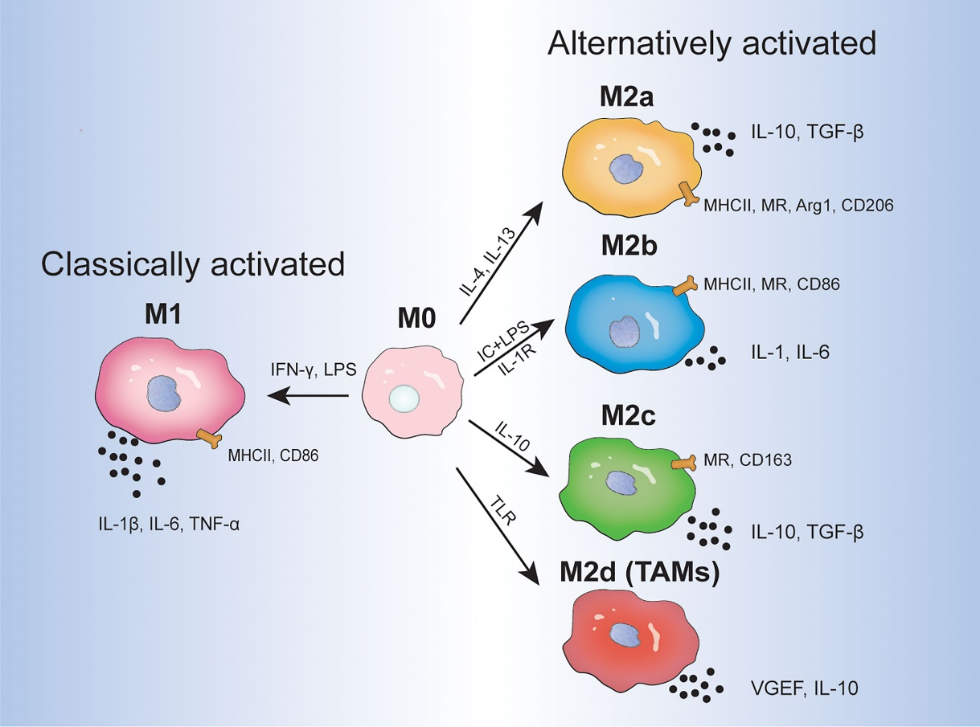
Why Macrophage?

Slide 5
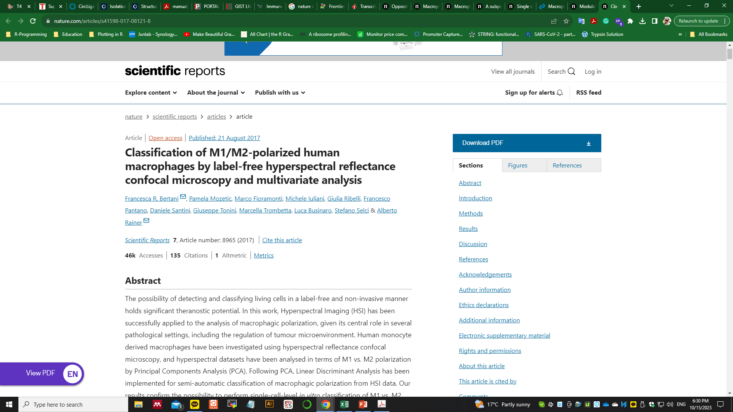
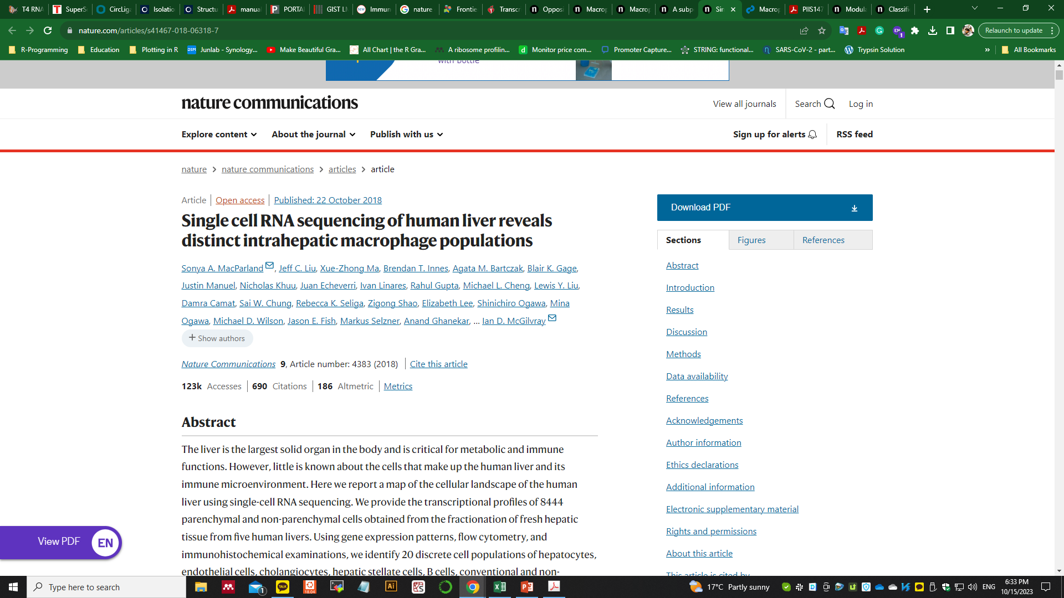
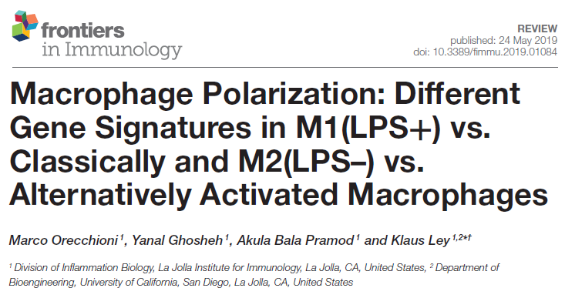
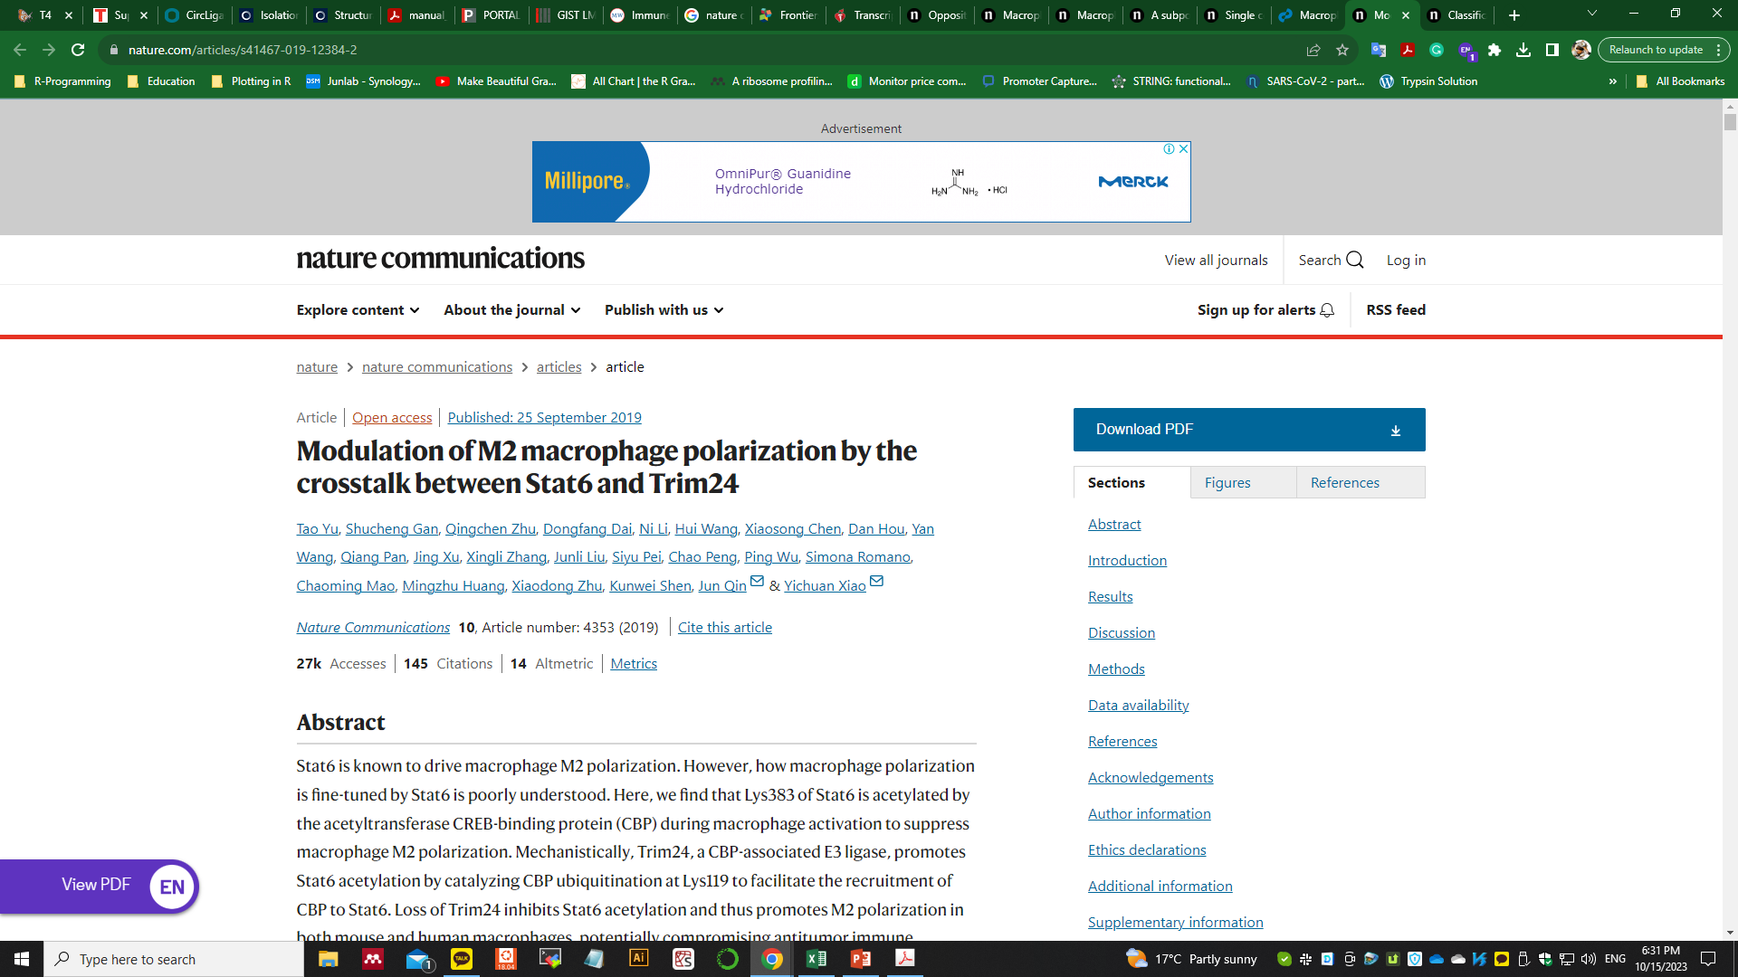
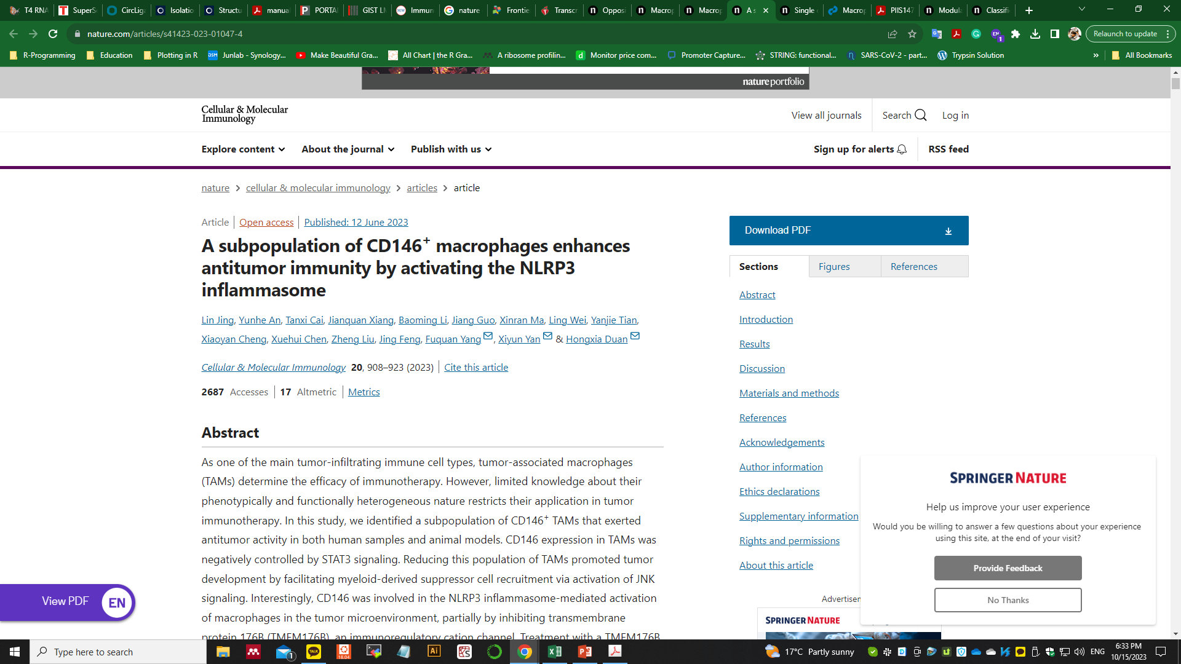
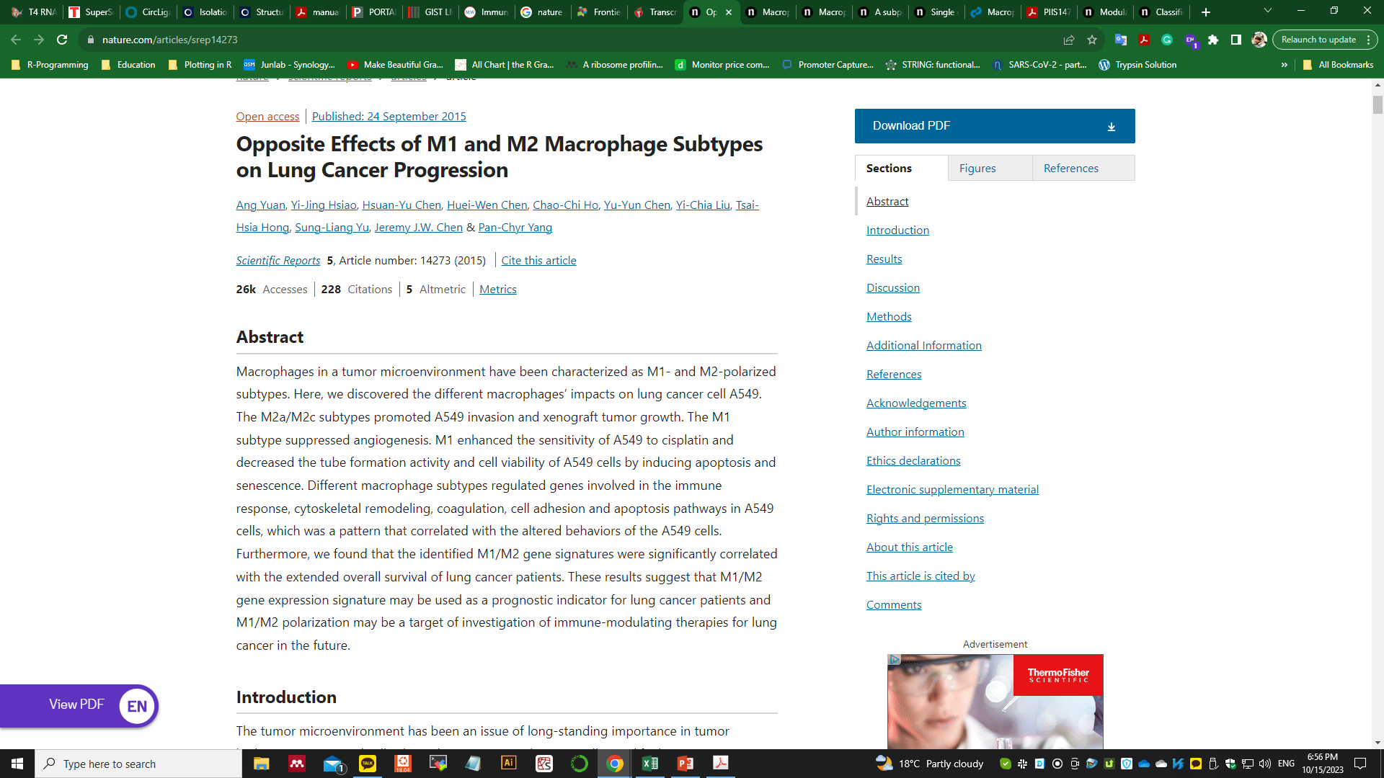
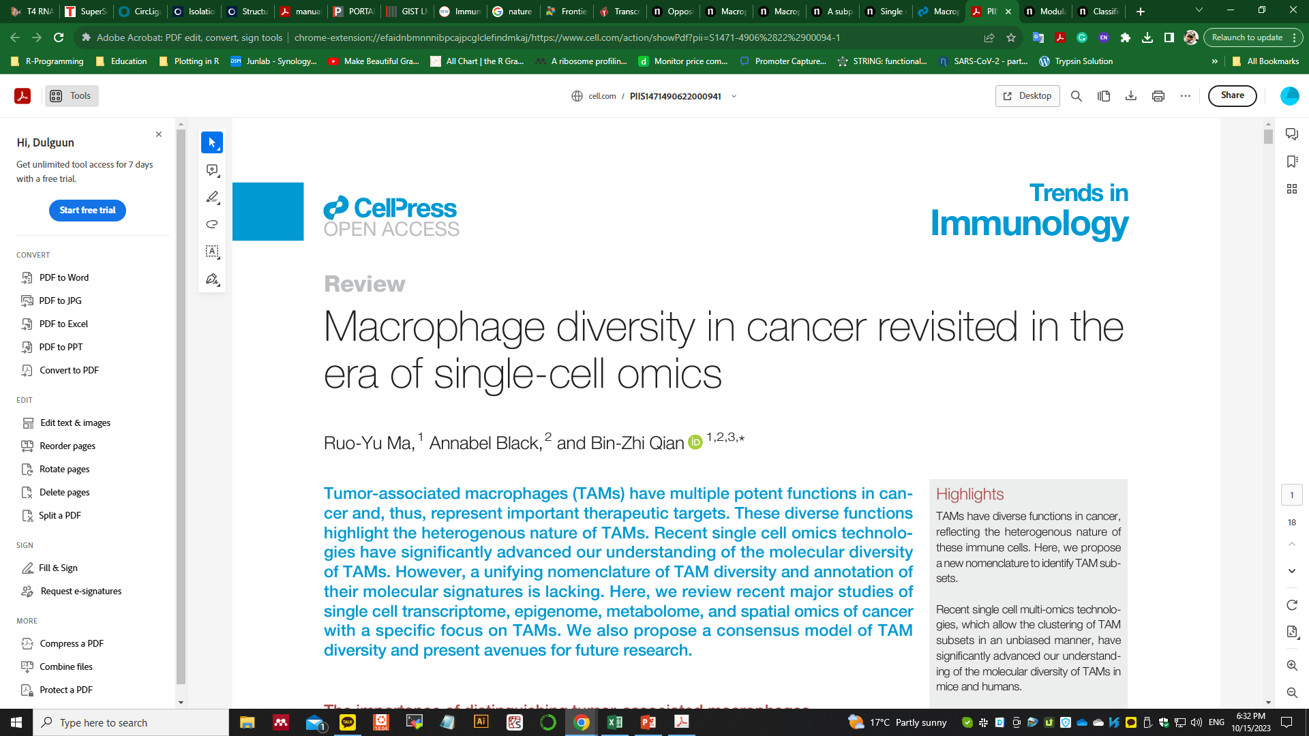
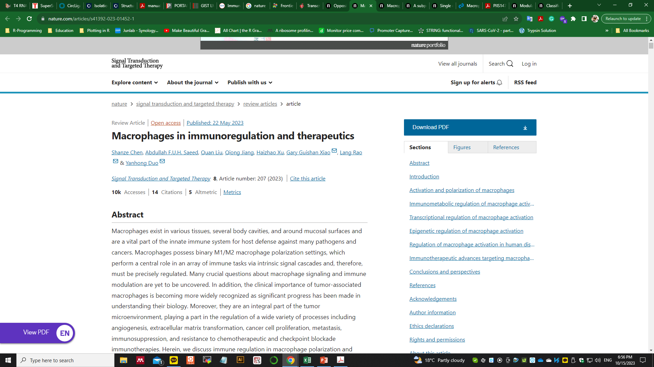
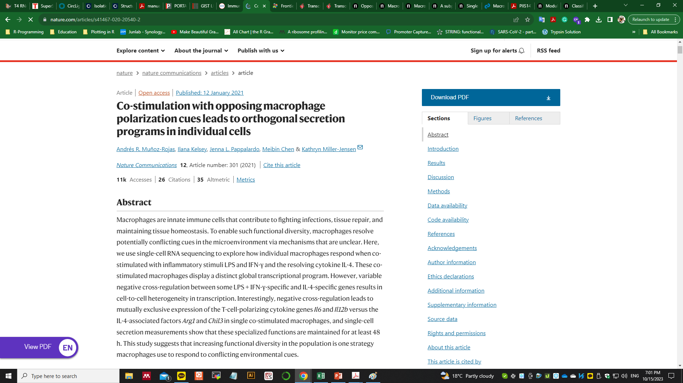
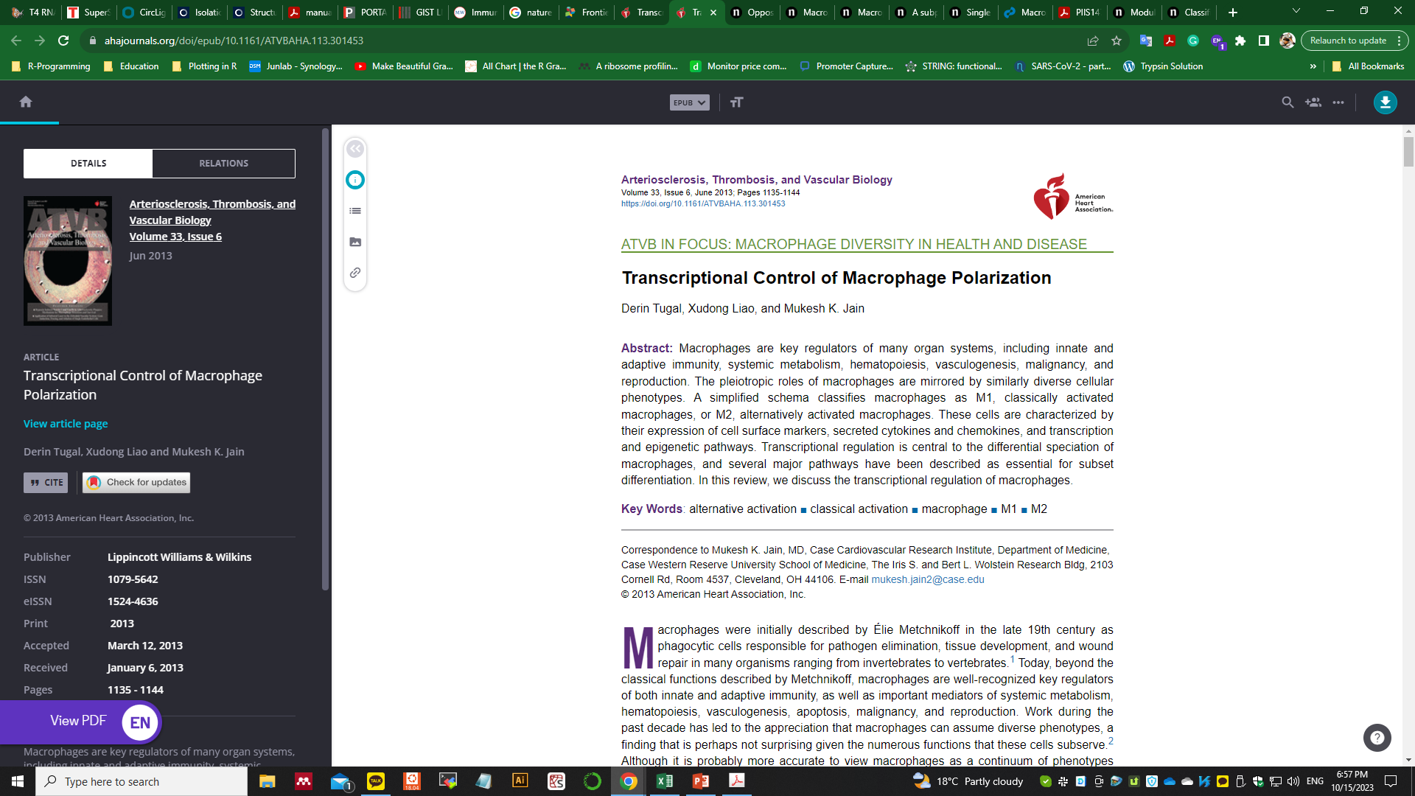
Related studies throughout the decade

Slide 6
The purpose of the project
In vivo baseline signatures?
Tissue residential vs peripheral circulation differences?
Baseline signature differences between in vivo vs in vitro
Within tissue resident, M1 macrophage baseline difference and their functionality towards the environment?

Slide 7




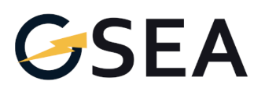




Methodology
Data mining
Unix based analysis
Fastq (UseGalaxy) > FeatureCounts > raw count data
DEG analysis
R program based analysis > edgeR
Python based analysis > DESeq2
Python based analysis
Standard analysis (due to flexibility)
Pathway analysis GSEA / gseapy
Figure presentation
Matplotlib vs GGplot2

Slide 8

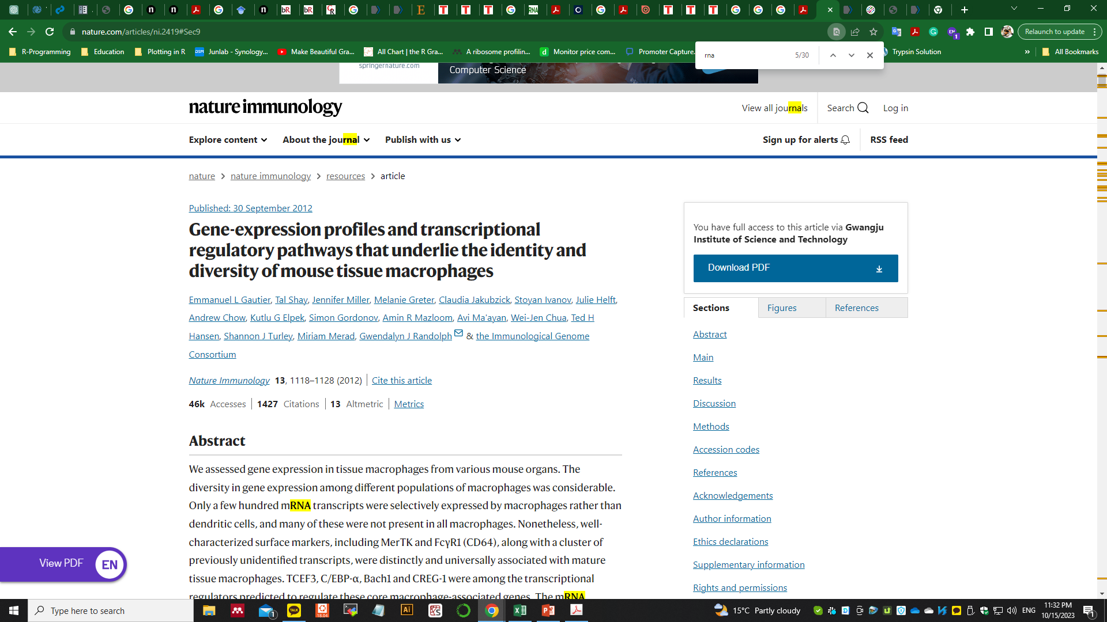
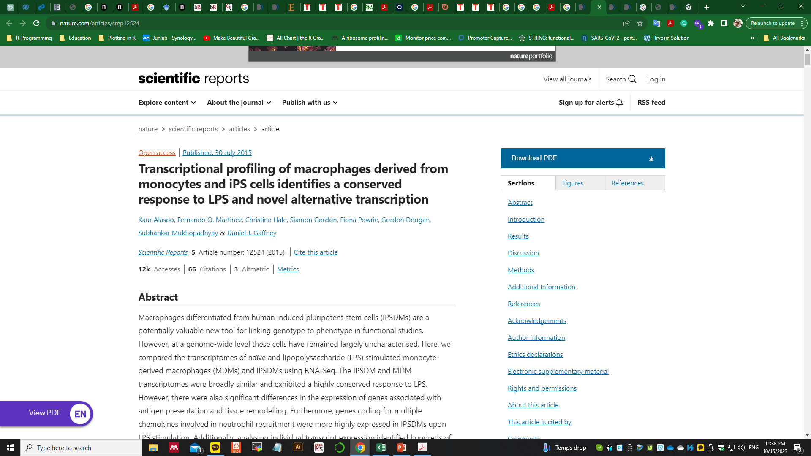
Selected data (publications) for analysis
IF: 7.3
IF: 31.25
IF: 4.997

Slide 9
Expectation of analysis
Baseline control cells have different abundance of gene signatures due to their environmental cue
Stimulation towards M1 differentiation causes increase or decrease of these baseline genes in a different way
Baseline gene signatures show what genes are the main components of macrophage and can be the control group hallmark for wet experimental procedure (works as a control group for qPCR or WB or ELISE etc) instead of abundant genes such as Actin or Gadph etc.

Slide 10
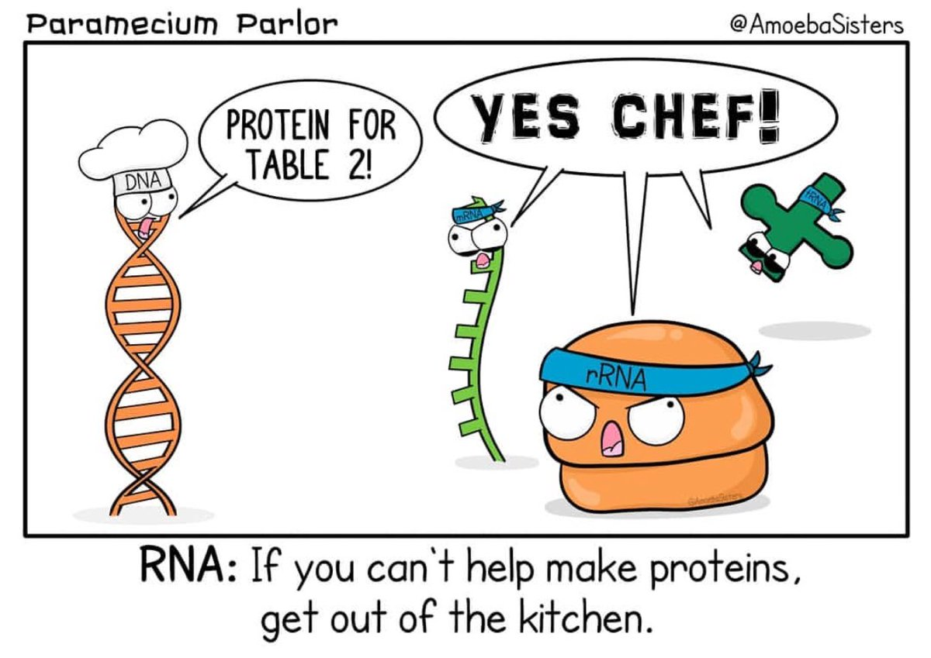
Thank you all. Any questions?

